Slide 1
Engineering Management Principles and Economics
Lecture 9
Other Analysis Techniques
Dr C.J. Willis, CAPM, P.Eng
‹#›

Slide 2
Learning Objectives
Learners will be introduced to other analysis techniques:
Future Worth Analysis
Benefit–Cost Ratio
Payback Period Analysis
Sensitivity Analysis
Break-even Analysis
Dr C.J. Willis, CAPM, P.Eng
‹#›

Slide 3
Future Worth Analysis
In contrast to present worth analysis, one might want to know the situation of a set of alternatives at any point in time in the future.
Future worth analysis is very similar to present worth analysis but the analysis exists at some future point in time.
As in present worth analysis, the evaluation of alternatives must be over the same time period.
This implies that the use of LCM or a specified time period is needed.
Dr C.J. Willis, CAPM, P.Eng
‹#›

Slide 4
Future Worth Analysis
A 20 year old university student smokes about twenty cigarettes a week. He wonders how much he could accumulate by age 65 if he quit smoking now and put his cigarette money into a savings account. Cigarettes cost $85 a carton. The student expects that a savings account would earn 5% interest, compounded semi-annually. Compute the student’s future worth at age 65. (Assume the student smokes 1 carton per week)
Dr C.J. Willis, CAPM, P.Eng
‹#›
Notes:
‹#›

Slide 5
Future Worth Analysis
Amount the student spends on cigarettes in half a year = $85/carton x 26 weeks = $2,210
Therefore, the student will have a semi-annual saving of $2,210
5% interest compounded semi-annually = 2.5% per interest period (half a year)
No. of interest periods = (65-20)*2=90
Future Worth = A(F/A,2.5%,90) = 2,210 (329.2) = $727,532
Dr C.J. Willis, CAPM, P.Eng
‹#›
Notes:
In present worth analysis alternatives are compared in terms of their present consequences
In annual cash flow analysis, the comparison was in terms of equivalent uniform annual costs (or benefits)
Future worth analysis allows us to determine what the future situation will be, if we take some particular course of action now.
‹#›

Slide 6
Benefit-Cost Ratio Analysis
At a given minimum attractive rate of return (MARR) we would consider an alternative acceptable when:
PW of benefits – PW of costs >= 0
or
EUAB – EUAC >= 0
This could also be stated as a ratio:
PW of benefits/PW of costs ≥ 1
Called the Benefit–Cost Ratio
Benefit-Cost ratio analysis is based on the ratio of benefits to costs by means of either present worth or annual cash flow calculations
Dr C.J. Willis, CAPM, P.Eng
‹#›
Notes:
A benefit cost ratio less than 1 is undesirable.
To use benefit cost ratio we must convert our cash flows to either the present or an annual amount
‹#›

Slide 7
Benefit-Cost Ratio Analysis
 | Situation | Criterion
Fixed input | Amount of money or other input resources is fixed | Maximize B/C
Fixed output | Fixed task, benefit, or other output to be accomplished | Maximize B/C
Neither input nor output fixed | Neither amount of money or other inputs nor amount of benefits or other outputs is fixed | Two alternatives: compute the incremental benefit-cost ratio (ΔB/ΔC) on the increment of investment between the alternatives. If ΔB/ΔC ≥ 1, choose the higher-cost alternative; otherwise, choose the lower cost alternative. Three or more alternatives: solve by benefit-cost ratio incremental analysis
Dr C.J. Willis, CAPM, P.Eng
‹#›

Slide 8
Benefit-Cost Ratio Analysis
Example
A firm is trying to decide which of two devices to install to reduce costs. Both devices have useful lives of five years and no salvage value. Device A costs $1000 and can be expected to result in a $300 savings annually. Device B costs $1350 and will provide cost savings of $300 the first year, but savings will increase by $50 annually, making the second year savings $350, the third year savings $400, and so forth. With interest at 7%, which device should the firm purchase?
Dr C.J. Willis, CAPM, P.Eng
‹#›

Slide 9
Benefit-Cost Ratio Analysis
Solution:
Incremental Cost: B-A = $1350 - $1000 = $350
PW of Cost = $350 (this is the incremental difference between the two alternatives)
PW Benefits = 50(P/G,7%,5)
= 50(7.647) = $382
ΔB/ΔC = PW of Benefits/PW of Costs = 382/350 = 1.09
Dr C.J. Willis, CAPM, P.Eng
‹#›
Notes:
The rule in all situations is to minimize the payback period.
‹#›

Slide 10
Benefit-Cost Ratio Analysis
Two machines are being considered for purchase. Assuming 10% interest, which machine should be bought?
 | Machine X | Machine Y
Initial Cost | $200 | $700
Uniform annual benefit | $95 | $120
End-of-useful-life salvage value | $50 | $150
Useful life, in years | 6 | 12
Dr C.J. Willis, CAPM, P.Eng
‹#›

Slide 11
Benefit-Cost Ratio
Cash flow table (assuming a 12-year analysis period)
To solve this problem we use B/C = EAUB/EUAC
Year | Machine X | Machine Y
0 | -$200 | -$700
1-5 | +95 | +120
6 | +95 -200 +50 | +120
7-11 | +95 | +120
12 | +95 +50 | +120 +150
Dr C.J. Willis, CAPM, P.Eng
‹#›
Notes:
The Atlas scale has lower cumulative benefits than the Tom Thumb scale.
Clearly the cumulative benefits of the Tom thumb scale is greater than the Atlas scale. The Tom thumb scale would be the better investment. In this case the payback period results in the selection of the wrong alternative.
If present worth analysis is used, the Tom Thumb scale would be selected. This is because the $700 end of useful life salvage value is considered. The salvage value is ignored in payback period analysis
Although payback period may lead to the wrong decision, it is still used as the calculations are easy for people unfamiliar with economic analysis. Also, payback period is easily understood.
Also, payback period measures how long it takes for the cost of the investment to be recovered, which firms are often interested in.
‹#›

Slide 12
Benefit-Cost Ratio
If we consider the salvage value to be reductions in costs rather than increase in benefits
Machine X
EUAC = 200(A/P,10%,6) – 50(A/F,10%,6)
= 200(0.2296) – 50(0.1296) = 46-6 = 40
EUAB = $95
Dr C.J. Willis, CAPM, P.Eng
‹#›
Notes:
Sensitivity analysis is computing how much an estimate will need to change to change a particular decision
‹#›

Slide 13
Benefit-Cost Ratio
Machine Y
EUAC = 700(A/P,10%,12) – 150(A/F,10%,12)
= 700(0.1468) – 150(0.0468) = 103 – 7 =$96
EUAB = $120
Incremental Benefit/Cost ratio, i.e. Machine Y – Machine X
ΔB/ΔC = 120-95/96-40 = 0.45
Since the incremental benefit-cost ratio is less than 1, it represents an undesirable increment of investment. We choose the lower-cost alternative, machine X.
Dr C.J. Willis, CAPM, P.Eng
‹#›
Notes:
When I talk about stage construction I am talking about delaying the construction of aspects of a facility
‹#›

Slide 14
Payback Period
Payback period is:
The period of time required for the profit or other benefits of a project to equal the cost.
Note: Interest Rate is NOT considered
Four important points:
This is an approximate calculation.
All costs/benefits/savings are included with no consideration of timing differences.
All economic consequences beyond the payback are ignored.
Due to its approximate nature, it may not select the correct alternative.
The rule in all situations is to minimize payback period
Dr C.J. Willis, CAPM, P.Eng
‹#›
Notes:
We see that the PW of cost for two-stage construction decreases as the second stage is deferred
The break-even point on the graph is the point where both alternatives have the same PW.
We see that if the second stage is deferred for 15 years, then the PW of the cost for the two stage construction is equal to the one-stage construction.
Year 15 is the break-even point
If the second stage construction were to be needed before year 15, then the one-stage construction, with its smaller PW of cost, would be preferred.
If the second-stage were not needed until after 15 years, two stage construction would be preferred.
The decision on how to construct the project is sensitive to the age at which the second stage is needed only if the range of estimates includes 15 years.
If one were to estimate that the second-stage capacity would be needed between 5 and 10 years hence, the decision is insensitive to that estimate.
‹#›

Slide 15
Payback Period
The cash flows for two alternatives are as follows:
Year | A | B
0 | -$1000 | -$2783
1 | +200 | +1200
2 | +200 | +1200
3 | +1200 | +1200
4 | +1200 | +1200
5 | +1200 | +1200
You may assume the benefits occur throughout the year rather than just at the end of the year. On the basis of payback period, which alternative should be selected?
Dr C.J. Willis, CAPM, P.Eng
‹#›

Slide 16
Payback Period Example
Solution:
Alternative A= In the first 2 years, only $400 of the $1000 cost is recovered. The remaining $600 is recovered in the first half of year three. Payback period for alternative A is 2 ½ years
Alternative B= the annual benefits are uniform, therefore the payback period is $2,783/$1,200 per year = 2.3 years
To minimize the payback period, we choose alternative B.
Dr C.J. Willis, CAPM, P.Eng
‹#›

Slide 17
Payback Period Example
A firm is trying to decide which of two weighing scales it should install to check a package-filling operation in the plant. If both scales have a six-year life, which one should be selected? Assume an 8% interest rate.
Alternative | Cost | Uniform Annual Benefit | End-of-useful-life Salvage Value
Atlas Scale | $2000 | $450 | $100
Tom Thumb Scale | $3000 | $600 | $700
Dr C.J. Willis, CAPM, P.Eng
‹#›

Slide 18
Payback Period Example
Solution
Atlas Scale:
Payback period = cost/uniform annual benefit
= 2000/450 = 4.4 years
Tom Thumb Scale :
Payback period = cost/uniform annual benefit
= 3000/600 = 5 years
Dr C.J. Willis, CAPM, P.Eng
‹#›

Slide 19
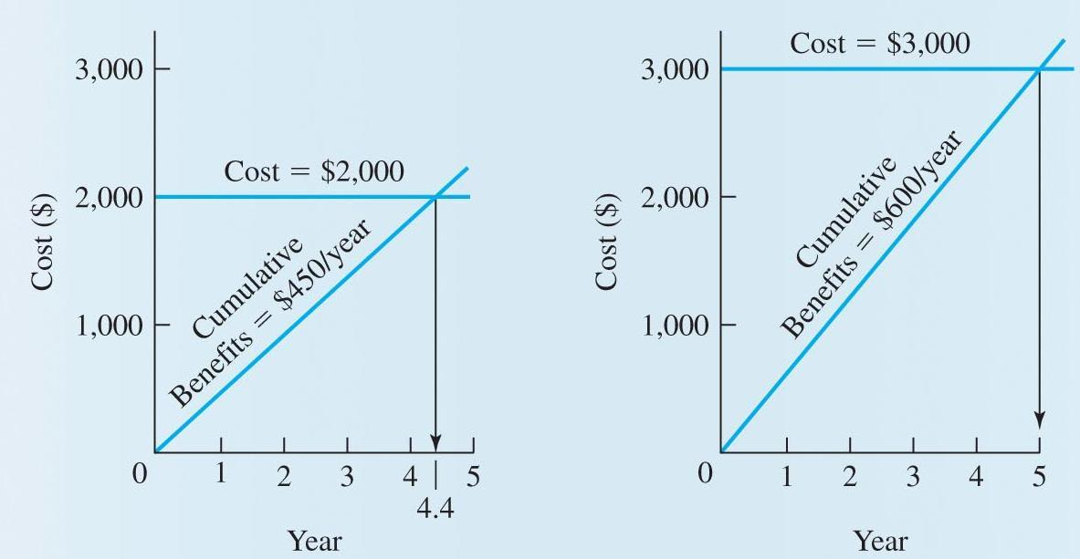
Payback Period Example
Dr C.J. Willis, CAPM, P.Eng
‹#›

Slide 20
Sensitivity Analysis
Since economic problem solving often considers future consequences, there is uncertainty regarding accuracy.
When small variations in an estimate would change which alternative is selected, the decision is said to be sensitive to the estimate
To better evaluate the impact of estimates, we can compute how much an estimate would need to change in order to change a particular decision.
This is ‘Sensitivity Analysis’.
Dr C.J. Willis, CAPM, P.Eng
‹#›
Notes:
Assume the student smokes 1 cartoon a week
What is the 5%? Is the nominal interest rate
What is n? n should be in terms of half year.
‹#›

Slide 21
Break-Even Analysis
Break-Even Analysis is a form of sensitivity analysis.
Typically presented as a break-even chart.
It indicates the point at which two alternatives are equal to each other.
Another term that is sometimes used for the breakeven point is the point of indifference
One application of break-even analysis is stage construction.
Should a facility be constructed now to meet its future full scale requirement, or should it be constructed in stages as the need for the increased capacity arises?
Dr C.J. Willis, CAPM, P.Eng
‹#›
Notes:
(F/A,i,n) is the uniform payment series compound amount factor
The student is 20 years old and we want to know the future worth when he is 65 (65-20)
‹#›

Slide 22
Break-even Analysis Example
Consider a project that may be constructed to full capacity now or may be constructed in two stages.
 | Construction Costs
Two Stage Construction
Construction first stage now | $100,000
Construction second stage n years from now | $120,000
Full Capacity Construction
Construct full capacity now | $140,000
All facilities will last 40 years regardless of when they are installed
The annual cost of operation and maintenance is the same for both types of construction
Assume an 8% interest rate
Dr C.J. Willis, CAPM, P.Eng
‹#›

Slide 23
Break-Even Analysis Example
Plot “age when second stage is constructed” versus “costs for both alternatives”. Mark the break-even point on your graph. What is the sensitivity of the decision to second-stage construction 16 or more years in the future?
Solution:
Since we are dealing with a common analysis period the calculations may be either annual cost or present worth. Present worth calculations are used.
Construct full capacity now
PW of cost= $140,000
Two stage construction
The first stage is constructed and the second stage is constructed in n years
Dr C.J. Willis, CAPM, P.Eng
‹#›

Slide 24
Break-even Analysis Example
PW of cost = 100,000 + 120,000(P/F,8%,n)
n=5 PW=100,000 + 120,000(0.6806)=$181,700
n=10 PW=100,000 + 120,000(0.4632)=$155,600
n=20 PW=100,000 + 120,000(0.2145)=$125,700
n=30 PW=100,000 + 120,000(0.0994)=$111,900
These data are plotted in the form of a breakeven chart
Dr C.J. Willis, CAPM, P.Eng
‹#›
Notes:
Table presents the criteria for using the benefit-cost ratio. When we have just two alternatives we compute the incremental benefit cost ratio.
For ΔB/ΔC ≥ 1 we choose the alternative with a higher initial cost because the increment of investment is justified, i.e. the incremental cost increase provides a greater incremental benefit increase.
When given two alternatives, we do not compute the benefit-cost ratio for each alternative and then compare them. We compute the benefit-cost ratio in the incremental difference between alternatives.
‹#›

Slide 25
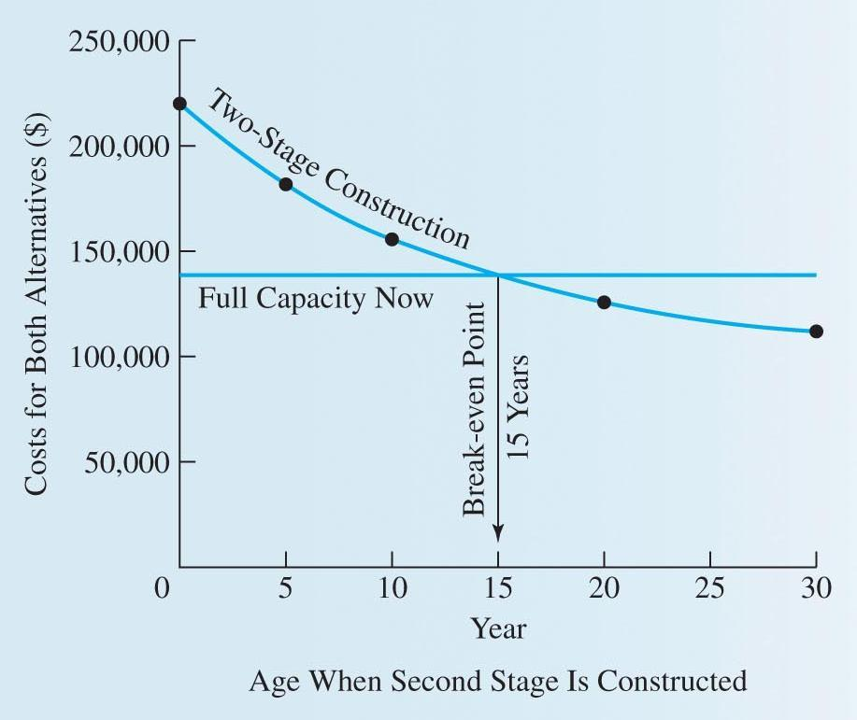
Break-Even Analysis, cont’d.
Shows present worth of building both stages now versus building a second stage at a later date.
The point at which they are equal is when the second stage is built in year 15.
Dr C.J. Willis, CAPM, P.Eng
‹#›
Notes:
Here neither input nor output is fixed. We do incremental benefit-cost ratio analysis.
‹#›

Slide 26
Break Even Analysis Cont’d.
We see that the PW of cost for two-stage construction decreases as the second stage is deferred
The break-even point on the graph is the point where both alternatives have the same PW.
We see that if the second stage is deferred for 15 years, then the PW of the cost for the two stage construction is equal to the one-stage construction.
Year 15 is the break-even point
If the second stage construction were to be needed before year 15, then the one-stage construction, with its smaller PW of cost, would be preferred.
Dr C.J. Willis, CAPM, P.Eng
‹#›

Slide 27
Break Even Analysis Cont’d.
If the second-stage were not needed until after 15 years, two stage construction would be preferred.
The decision on how to construct the project is sensitive to the age at which the second stage is needed only if the range of estimates includes 15 years.
If one were to estimate that the second-stage capacity would be needed between 5 and 10 years hence, the decision is insensitive to that estimate.
Dr C.J. Willis, CAPM, P.Eng
‹#›

Slide 28
Summary
Future Worth Analysis
Comparisons between alternatives made based on a future time
Benefit-Cost Ratio Analysis
Analyzes the ratio of benefits to costs through present worth or annual worth.
Incremental benefit-cost ratios are used for multiple alternatives when neither input nor output are fixed.
Dr C.J. Willis, CAPM, P.Eng
‹#›

Slide 29
Summary, cont’d.
Payback Period Analysis
The period of time required for profit or other benefits to equal the cost of the investment.
A poor method for ranking alternatives because interest rate is NOT considered.
Simply measures the time it takes to recover the investment in original dollars.
Dr C.J. Willis, CAPM, P.Eng
‹#›

Slide 30
Summary, cont’d.
Sensitivity Analysis
Used to determine how sensitive a decision is to estimates and parameters.
Examination of the range of values to determine their effect on a decision.
Break-Even Analysis
To locate the condition where alternatives are equivalent.
Often uses a break-even chart.
Dr C.J. Willis, CAPM, P.Eng
‹#›

